Slide 1

Customer Shopping Behavior Analysis
Uncovering insights from 3,900 purchases to guide strategic business decisions through data-driven analysis of spending patterns, customer segments, and product preferences.

Slide 2

DATASET OVERVIEW
Project Foundation
3,900
18
37
Total Purchases
Data Columns
Missing Values
Transactions analyzed across various product categories
Comprehensive features covering demographics and behavior
Only in Review Rating column, handled through imputation
Key features include customer demographics, purchase details, and shopping behavior metrics to enable comprehensive analysis.

Slide 3

PYTHON
Data Preparation & Cleaning
01
02
03
Data Loading & Exploration
Missing Data Handling
Feature Engineering
Imported dataset using pandas, checked structure with df.info() and summary statistics
Imputed Review Rating nulls using median rating per product category
Created age_group and purchase_frequency_days columns for deeper insights
04
05
Data Consistency
Database Integration
Standardized columns to snake case, removed redundant promo_code_used field
Connected to PostgreSQL and loaded cleaned data for SQL analysis

Slide 4
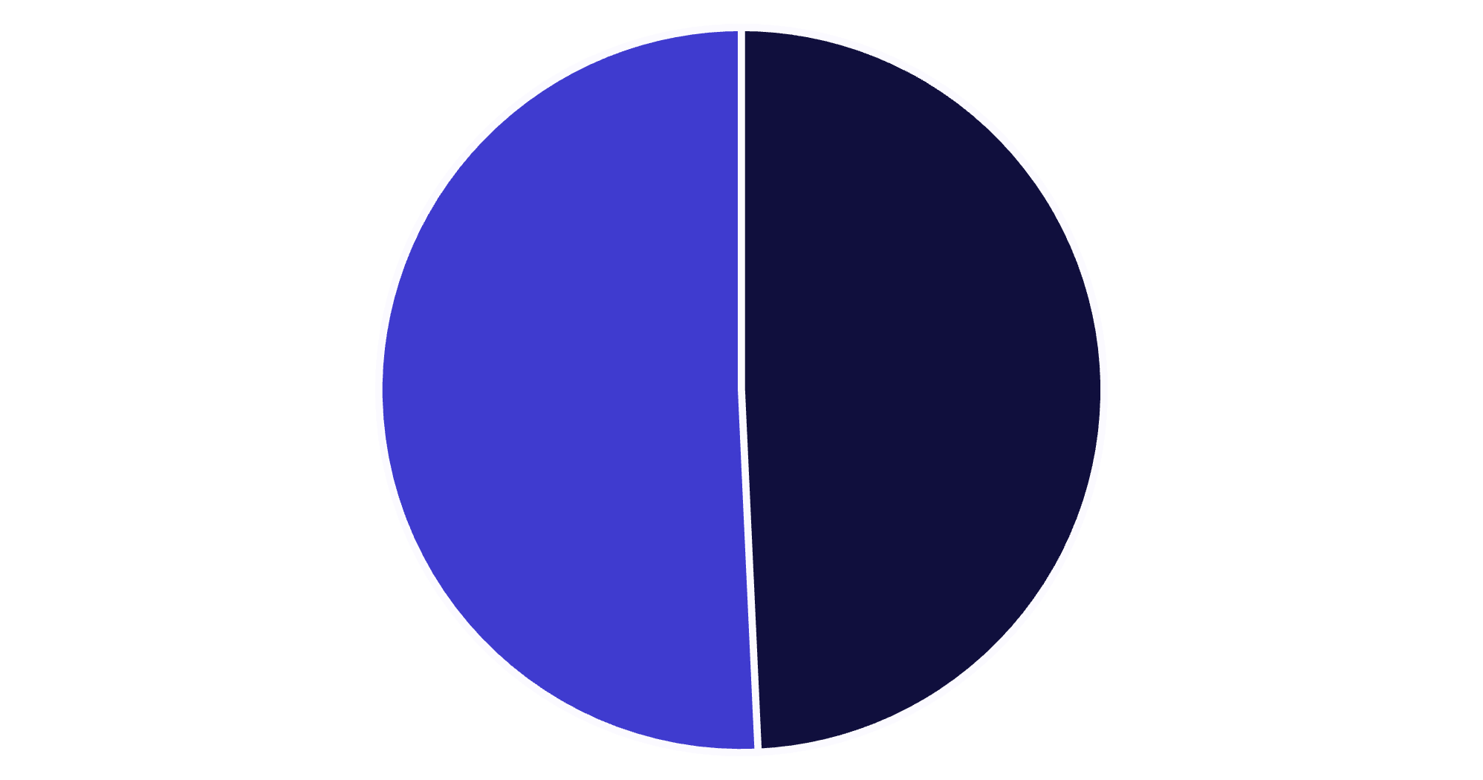
SQL ANALYSIS
Revenue by Gender
Gender Insights
Female customers generate slightly higher total revenue compared to male customers, suggesting balanced market appeal across genders.
Both segments contribute significantly to overall revenue, indicating successful cross-gender product positioning.
Male
Female

Slide 5

Top-Rated Products Drive Satisfaction
1
2
3
Blouse
Jewelry
Pants
Highest average review rating among all products
Second-highest customer satisfaction score
Strong performance in customer reviews
4
5
Shirt
Dress
Consistently positive customer feedback
Rounds out top 5 most-loved products

Slide 6

Shipping & Subscription Insights
Express Shipping
Standard Shipping
$60.18 average purchase
$59.76 average purchase
Premium shipping correlates with higher order values
Slight difference suggests shipping choice driven by urgency, not value
Subscriber Advantage
Subscribers generate significantly higher revenue compared to non-subscribers, demonstrating the value of loyalty programs.

Slide 7



CUSTOMER SEGMENTATION
Understanding Customer Loyalty
Returning Customers
Made multiple purchases, building relationship with brand
Loyal Customers
Frequent purchasers with established buying patterns
New Customers
First-time buyers exploring product offerings
Segmentation reveals opportunities to move customers up the loyalty ladder through targeted engagement strategies.

Slide 8


Discount Strategy Performance
High-Value Discount Users
Customers using discounts still spend above average purchase amounts, indicating discounts attract quality buyers.
Top products with discount-driven purchases include Blouse, Dress, and Pants—suggesting strategic promotion opportunities.
68%
32%
Repeat Buyers Subscribe
Non-Subscribers
Strong correlation between purchase frequency and subscription status
Opportunity to convert frequent buyers into subscribers

Slide 9

DASHBOARD
Power BI Analytics Dashboard
Comprehensive visualization bringing together all analysis parameters for real-time monitoring and strategic decision-making across customer segments, product performance, and revenue metrics.

Slide 10
STRATEGIC RECOMMENDATIONS
Actionable Business Insights
Boost Subscriptions
Loyalty Programs
Optimize Discounts
Promote exclusive benefits to convert high-frequency buyers into loyal subscribers
Reward repeat buyers to accelerate movement into "Loyal" customer segment
Balance promotional sales boosts with margin control for sustainable growth
Product Positioning
Targeted Marketing
Highlight top-rated and best-selling items in marketing campaigns
Focus efforts on high-revenue age groups and express-shipping users

